Slide 1
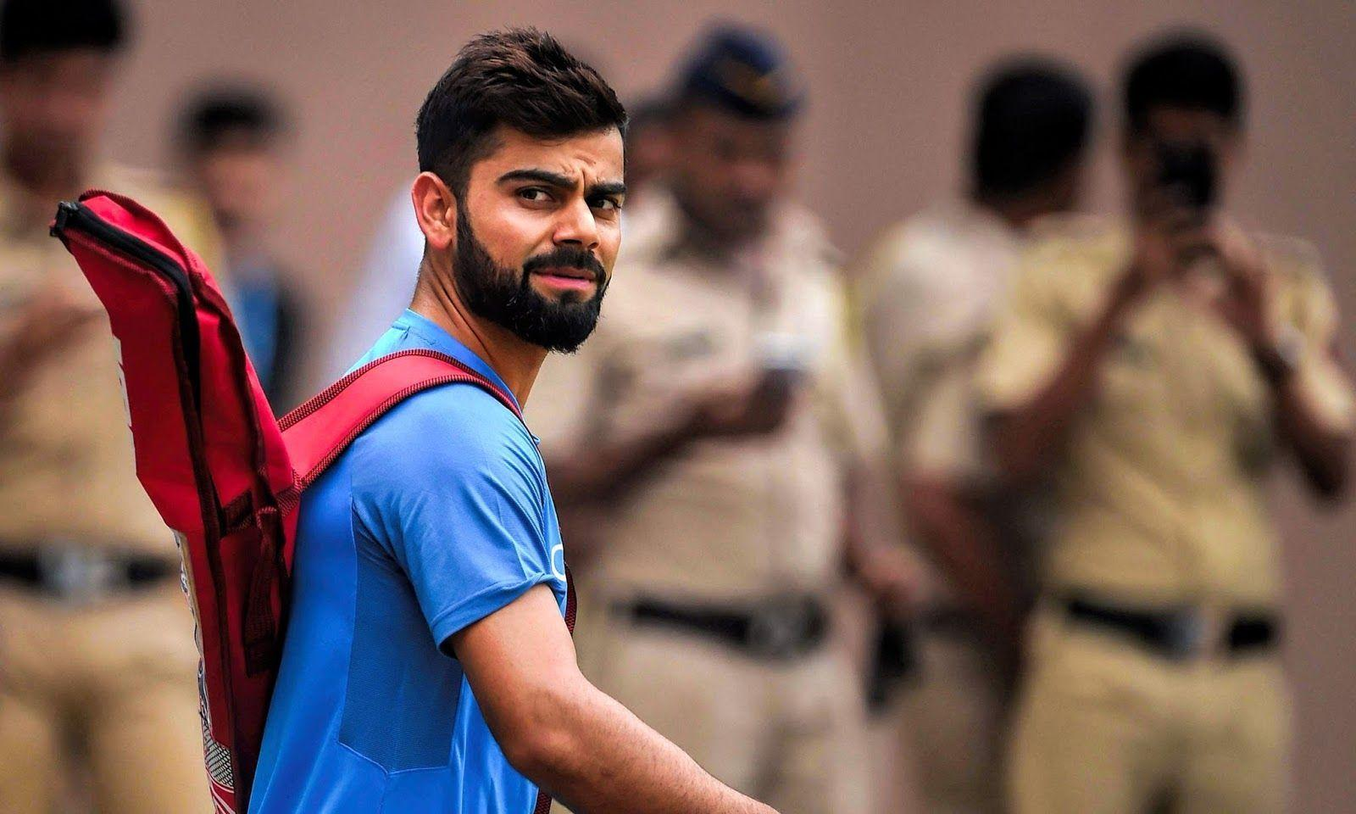
"Virat Kohli: The Modern Cricketing Legend"

Slide 2
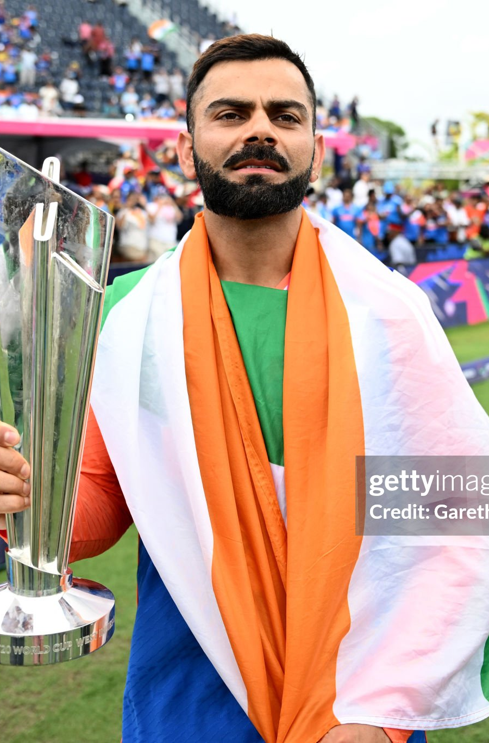
Introduction
Virat Kohli is widely regarded as one of the finest cricketers of his generation and an iconic figure in world cricket. Born on November 5, 1988, in Delhi, India, Kohli's passion and commitment to the game have earned him a reputation as one of the most successful batsmen in modern cricket.
Known for his aggressive playing style, impeccable technique, and exceptional consistency, Virat has achieved numerous records across all formats. He has been the captain of the Indian national cricket team and led the team to several historic victories, including in major tournaments like the ICC Champions Trophy and bilateral series around the world.

Slide 3
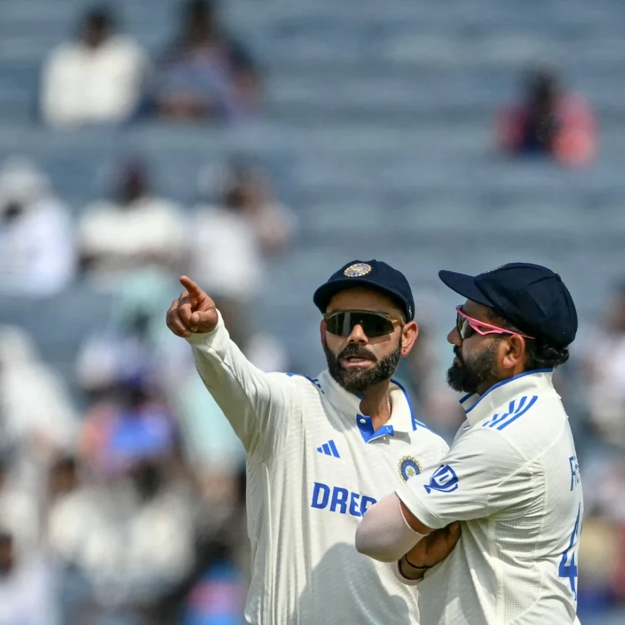
Leading the Indian cricket team
Virat Kohli's leadership and motivation in the Indian cricket team are remarkable.
1. He believes in teamwork and dedication, encouraging every player to give their best.
2. Kohli leads by example with his hard work and discipline, inspiring others to focus on their game.
3. He fosters team spirit and positivity, helping players overcome challenges and strive for success.

Slide 4
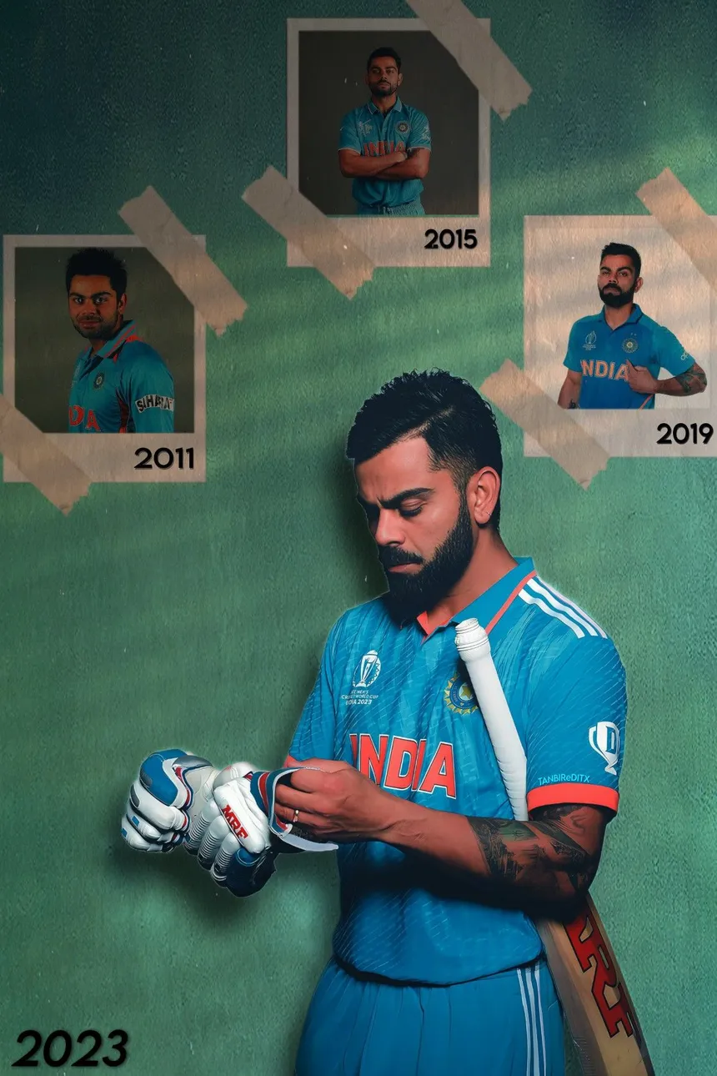
Challenges and comebacks :​
Overcoming Personal Loss to Achieve Greatness :
Century Drought :
Virat Kohli experienced a "drought of centuries" for a significant period, during which he did not score any international centuries after 2019. This period lasted from 2020 to 2021, when his form was somewhat inconsistent.
Virat Kohli faced an emotional challenge when his father passed away. His father, Prem Kohli, died in 2006 when Virat was just 18 years old. During this time, he encountered many challenges, but he transformed this grief into motivation for his career

Slide 5

Virat Kohli: A Glorious Journey Filled with Awards
Sir Garfield Sobers Trophy :
Awarded for the ICC Cricketer of the Year, Kohli won this in 2017, 2018, and 2022.
Rajiv Gandhi Khel Ratna Award:
This is India's highest sporting honor, which he received in 2018.
Padma Shri:
Kohli was awarded this prestigious civilian honor in 2017 for his contributions to Indian sports.
ICC Men's Cricketer of the Decade :
This prestigious award recognizes his outstanding performances across all formats of the game during that decade.
Arjuna Award
Virat Kohli was awarded the Arjuna Award in 2013. This award is given to recognize outstanding achievement in sports in India.

Slide 6
Impact on Society
1. Fitness Revolution
2. Role Model for Young Athletes
3. Philanthropy and Social Work:
4. Changing Attitudes Towards Mental Health:
5. Cultural Influence

Slide 7
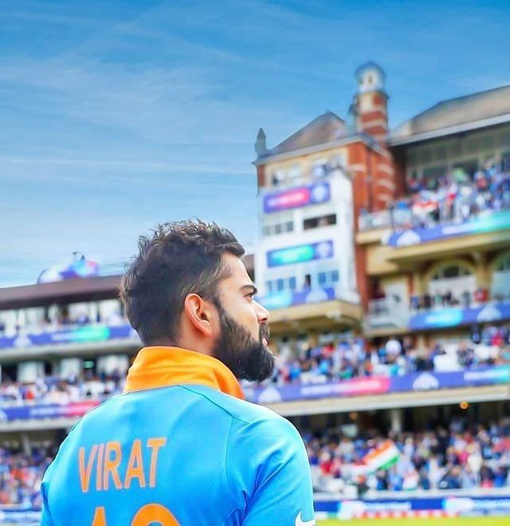
Conclusion
Virat Kohli has established himself as an exemplary figure in the world of cricket. His batting skills, leadership qualities, and dedication have made him not just a player, but an icon. His passion and hard work inspire not only him but also his teammates. Kohli's story teaches us that if we work hard for our dreams and never give up, we can overcome any challenge. His contributions have taken Indian cricket to new heights, and his legacy will always be remembered.

Slide 8
Thank you
“Never give up. Today is hard tomorrow will be worse. But the day after tomorrow will be sunshine." ~ virat kohli

